Slide 1

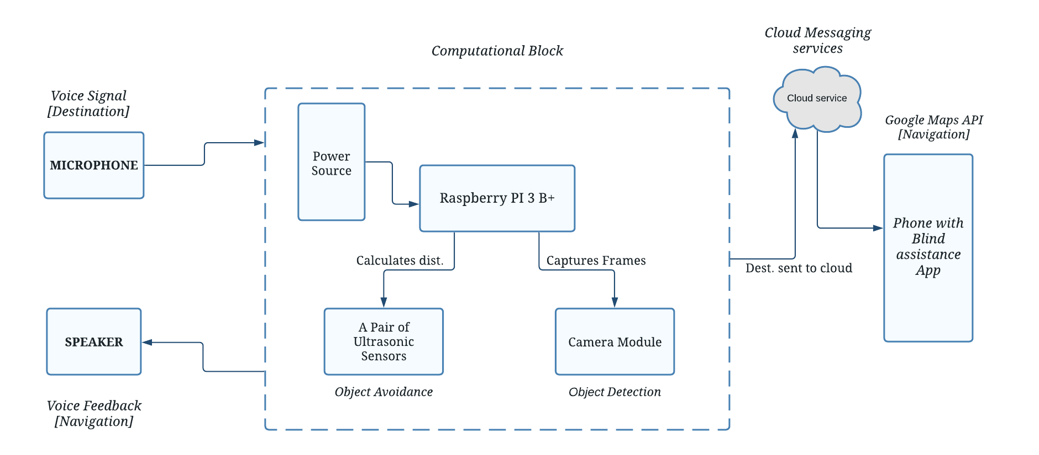
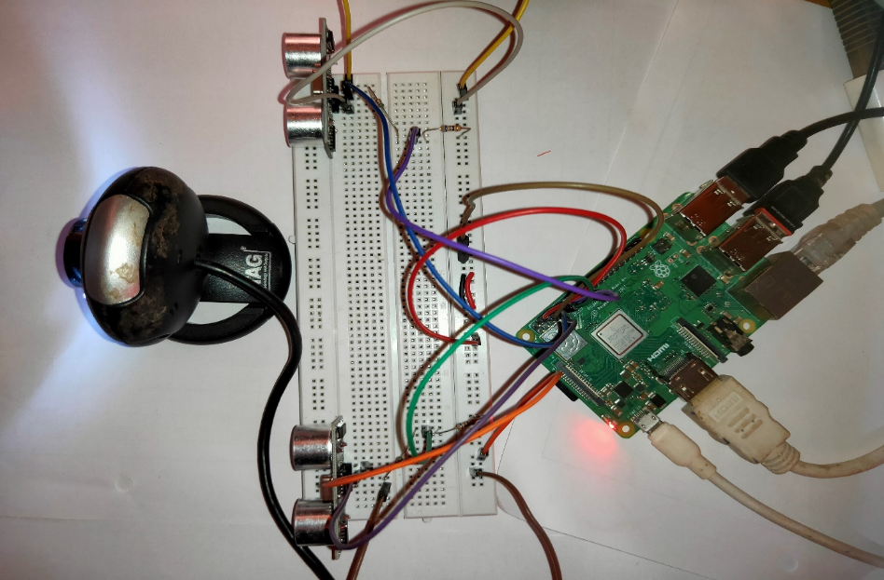
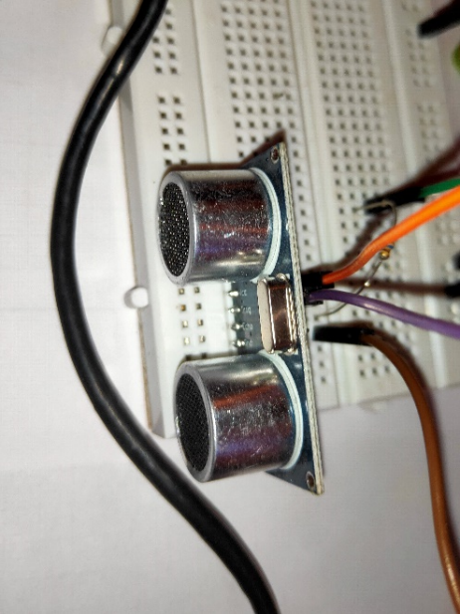
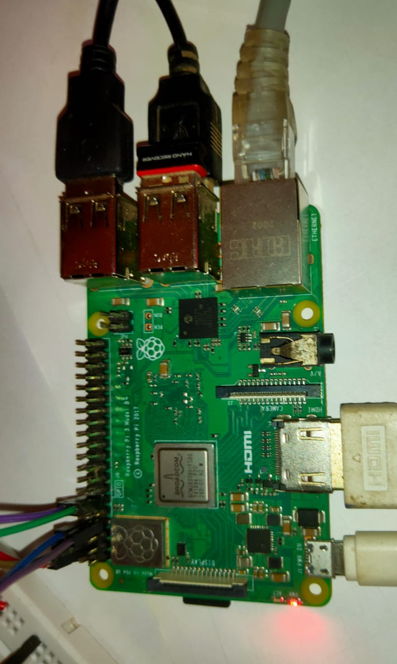
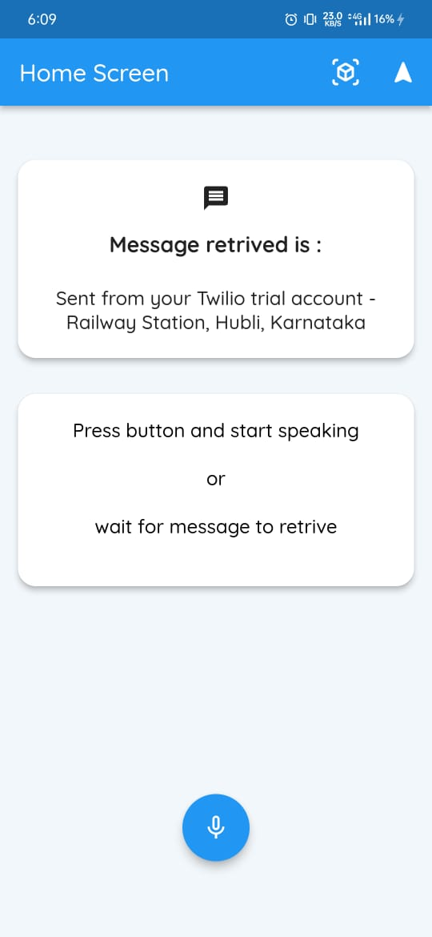
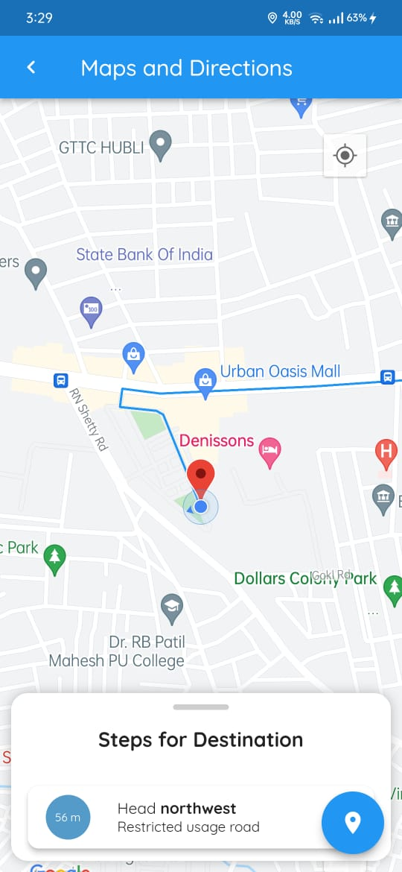
Navigation Assistance for Visually Impaired
Bharat Gunhalkar, Govind, Sandeep S P, Yash Mahale
Guide: Dr.Sujata.S.Kotabagi
School of Electronics and Communication
Problem statement
Methodology
Results
Develop a solution that can securely guide people with Moderate to Severe Visual Impairment (MSVI) to their destination using technologies such as real-time object detection and avoidance.
Objectives
The device should be able to accurately detect the object in the person’s vicinity.
It also be able to avoid the detected object using voice feedback system.
It should ask for the destination from the visually impaired and navigate the person safely to the desired destination.
It should be able to handle the complex computations of capturing the live frame and perform actions accordingly.
It must be cost effective and fast considering all the hardware constraints.
Perform well in indoor and outdoor conditions with better tradeoff between speed and accuracy.
The Raspberry PI 3B with an ARM Advanced RISC Machine; and RISC - Reduced instruction set computing technology is supplied with power from a constant 5v supply thereby instantiating the further process.
The ultrasonic sensor has a range of 2cm to 250cm which is suitable for our project.
The camera used has a max resolution of 1920x1080 and a min resolution of 640x480. The Object detection model that we are using takes the image of the size 640x480 which can work better with the Pi camera. The object detection model used SSD Mobile Net which works on the principle of single shot detection efficient for embedded devices.
Visually blind person is asked to provide with a destination using headset. Once the destination is picked up from the microphone of the headset, it is sent to a mobile application for making request to an underlying API for directions. Once the request is successful the app keeps updating the person with the directions, which is the first part of the project.
Simultaneously the camera module along with the sensors help the person with possible collision with the obstacle and the actions to be performed to avoid it. These instructions are sent via the Raspberry PI 3B to the headset. This is the second and the important part.
If the object is within 1.5 meters, then the ultrasonic sensors calculates the max distance of the two and at the same time using the camera It identifies the object in its vicinity and warns the person with the obstacle to avoid and the direction to take. This continues until the person reaches the destination.
.
Contributions
Development of this device can be helpful for the entire visually impaired community. This is a much safer option considering the traditional stick to detect the object.
This can improve the quality of living of the visually impaired people in a good way.
Voice Feedback via headset’s speaker
Conclusions
Literature survey
The vision-based guidance and navigation system for visually blind is designed, developed, and validated throughout experiments and iteratively optimized. The device is compliant to the principle of developing a highly performance device but cost effective with practical usage. The device is using disruptive technology and allows for updating and inclusion of new functions. The proposed device has been put through a series of outdoor conditions for real-time usage and the devices performs best at avoiding objects. The future scope of a device or system that assists a blind person is obviously very high.
According to research conducted Blindness affects about 3.2 percent of the world’s population. And India has the highest percentage in the world for people with Moderate to Severe Blindness.
Blind stick helps them with their disability to a certain extent, but they fail in aspects that require detection of fast-moving objects and instant decision-making. Often, these devices or technologies are designed only for specific tasks.

